Slide 1
Programming for problem solving
Presented by,
Devipriya M
Assistant professor
SRM IST Trichy

Slide 2
Arrays
To process large amounts of data, we need a powerful data type that would facilitate efficient storing, accessing and manipulation of data items. C supports a derived data type known as array that can be used for such applications.
An array is a fixed-size sequenced collection of elements of the same data type. It is simply a grouping of like-type data.
An array is a sequenced collection of related data items that share a common name.
For instance, we can use an array name salary to represent a set of salaries of a group of employees in an organization. We can refer to the individual salaries by writing a number called index or subscript in brackets after the array name. For example, salary [10] represents the salary of 10th employee.

Slide 3
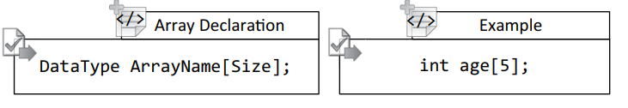
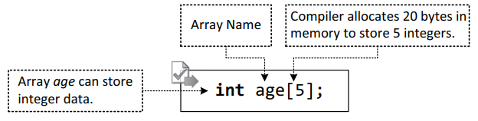
One dimensional array

Slide 4
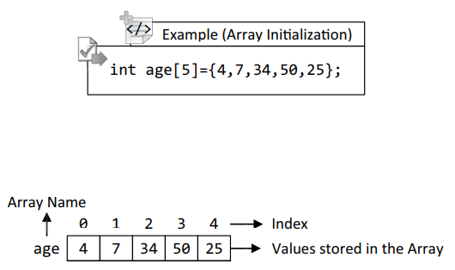
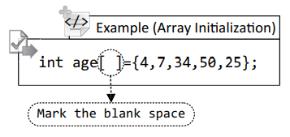
Initialization of arrays

Slide 5
Characteristics of an Array
An array is a collection of similar types of elements, which can be int, float, or char.
The first element in the array is numbered 0, so the last element is 1 less than the size of the array.
An array is also known as subscripted variables.
Before using an array, its type and dimension must be declared.
However big an array, its elements are always stored in contiguous memory locations.

Slide 6
Characteristics of an Array
If array variables are not assigned with any value, then they will contain garbage values.
Usually, an array of characters is called a “string.”
The array name represents the address of an array if it is not associated with any subscripts. Thus the array name age is equivalent to &age[0]

Slide 7
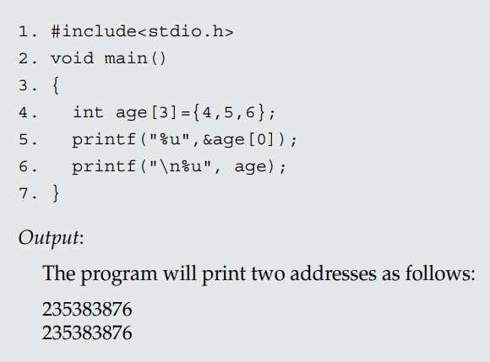
Address of the array

Slide 8

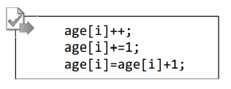
Arrays
We can use a subscripted variable anywhere as a normal variable for writing C statements.
For incrementing the ith element of a given array the following statement can also be used:

Slide 9
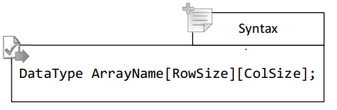
2D Arrays
In the 2D array, we require two subscripts to indicate one element. One subscript denotes the row number and the other subscript denotes the column number.
Like 1D arrays, the subscript value starts from 0 (zero).

Slide 10
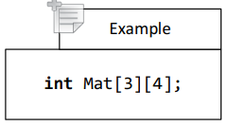
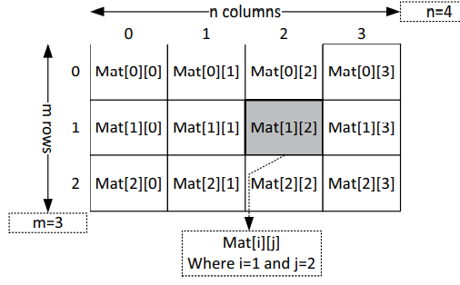
2D Array

Slide 11
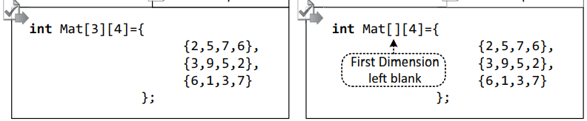
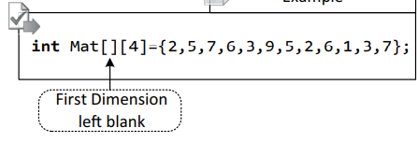
Initializing 2D array

Slide 12
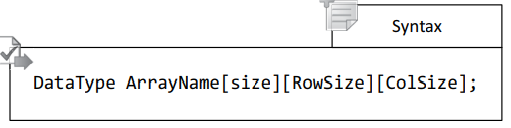
3D Arrays

Slide 13
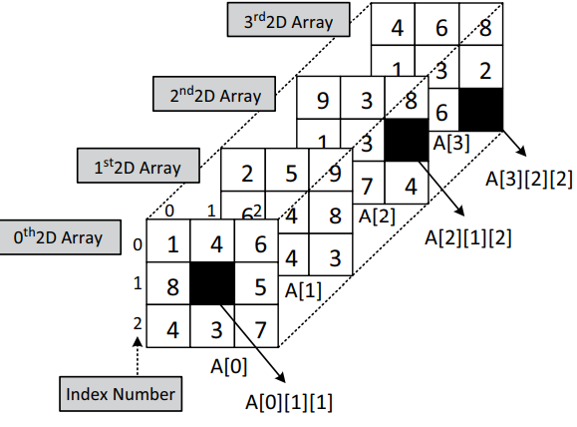
3D Arrays

Slide 14

3D Array
where,
2 indicates the number of 2D arrays;
3 represents the number of rows in each 2D array;
4 represents the number of columns in each 2D array.
According to the above declaration, array A can store 24 elements; 12 elements in each 2D array

Slide 15
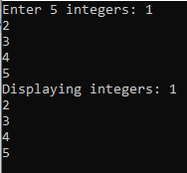
1D Array
#include <stdio.h>
int main() {
int values[5];
printf("Enter 5 integers: ");
// taking input and storing it in an array
for(int i = 0; i < 5; ++i) {
scanf("%d", &values[i]);
}
printf("Displaying integers: ");
// printing elements of an array
for(int i = 0; i < 5; ++i) {
printf("%d\n", values[i]);
}
return 0;
}

Slide 16
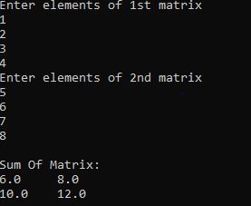
2D Array
#include <stdio.h>
int main()
{
float a[2][2], b[2][2], result[2][2];
printf("Enter elements of 1st matrix\n");
for (int i = 0; i < 2; ++i)
for (int j = 0; j < 2; ++j)
{
scanf("%f", &a[i][j]);
}
printf("Enter elements of 2nd matrix\n");
for (int i = 0; i < 2; ++i)
for (int j = 0; j < 2; ++j)
{
scanf("%f", &b[i][j]);
}
for (int i = 0; i < 2; ++i)
for (int j = 0; j < 2; ++j)
{
result[i][j] = a[i][j] + b[i][j];
}
printf("\nSum Of Matrix:\n");
for (int i = 0; i < 2; ++i)
{
for (int j = 0; j < 2; ++j)
{
printf("%.1f\t", result[i][j]);
}
printf("\n");
}
return 0;
}

Slide 17

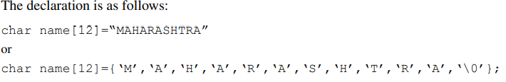

Char Array
The characters of a string are stored in contiguous (neighboring) memory locations.

Slide 18
Char Array
char first_name[15] = "ANTHONY";
char first_name[15] = {'A','N','T','H','O','N','Y','\0'}; // NULL character '\0' is required at end in this declaration
char string1 [6] = "hello";/* string size = 'h'+'e'+'l'+'l'+'o'+"NULL" = 6 */
char string2 [ ] = "world"; /* string size = 'w'+'o'+'r'+'l'+'d' = 5 */
char string3[6] = {'h', 'e', 'l', 'l', 'o', '\0'} ; /*Declaration as set of characters ,Size 6*/

Slide 19
// valid
char name[13] = "StudyTonight";
char name[10] = {'c','o','d','e','\0'};
// Illegal
char ch[3] = "hello";
char str[4];
str = "hello";

Slide 20
Char array
int main()
{
// array to store string taken as input
char color[20];
// take user input
printf("Enter your favourite color: ");
scanf("%s", color);
// printing the input value
printf("Your favourite color is: %s.", color);
return 0;
}

Slide 21
Char Array
char str[20];
printf("Enter a string");
scanf("%[^\n]", &str);
printf("%s", str);

Slide 22
Char array using scanf
#include<stdio.h>
void main()
{
int i;
char ch[3];
for(i=0;i<3;i++)
scanf("%c", &ch[i]);
printf("%s", ch);
}

Slide 23
Char array using get char
#include <stdio.h>
void main()
{
int i;
char ch;
char s[5];
printf (" Enter a character ( If we want to exit press #) \n");
while (i<5)
{
ch = getchar();
s[i]=ch;
i++;
}
printf("%s", s);
}

Slide 24
Char array using gets
#include <stdio.h>
int main () {
char str[50];
printf("Enter a string : ");
gets(str);
printf("You entered: %s", str);
return 0;
}

